Slide 1
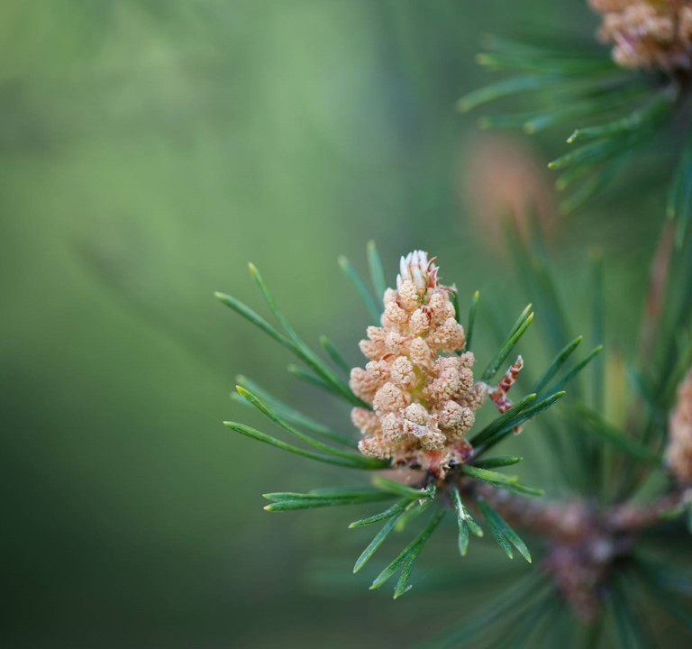
Eco School Award
Whole school
Assembly
Eco Committee

Slide 2
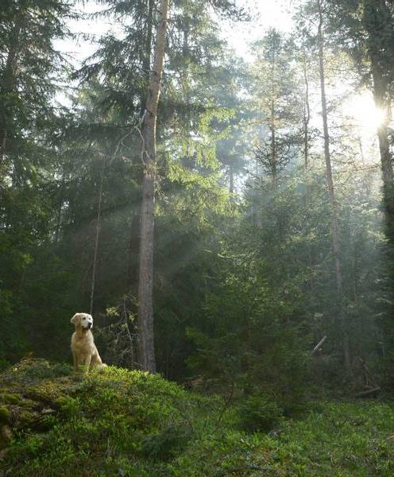
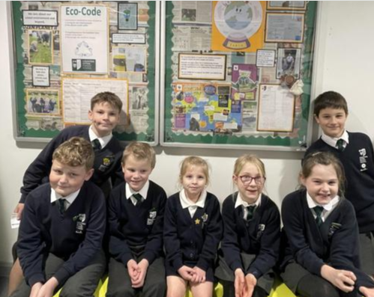
Our Eco Team

Slide 3
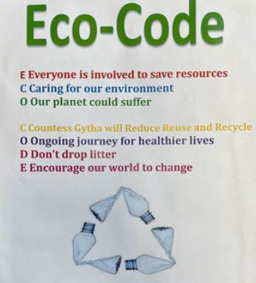
Our Eco code

Slide 4
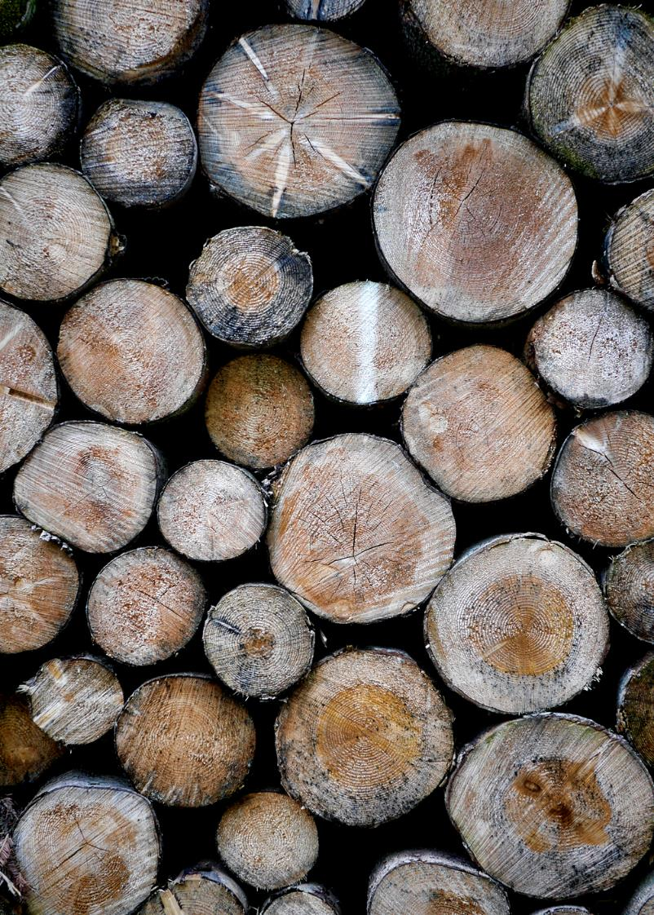
Topics as part of the award
Biodiversity
Water
Waste
Transport
School Grounds
Marine
Litter
Energy
Healthy Living
Global Citizenship

Slide 5

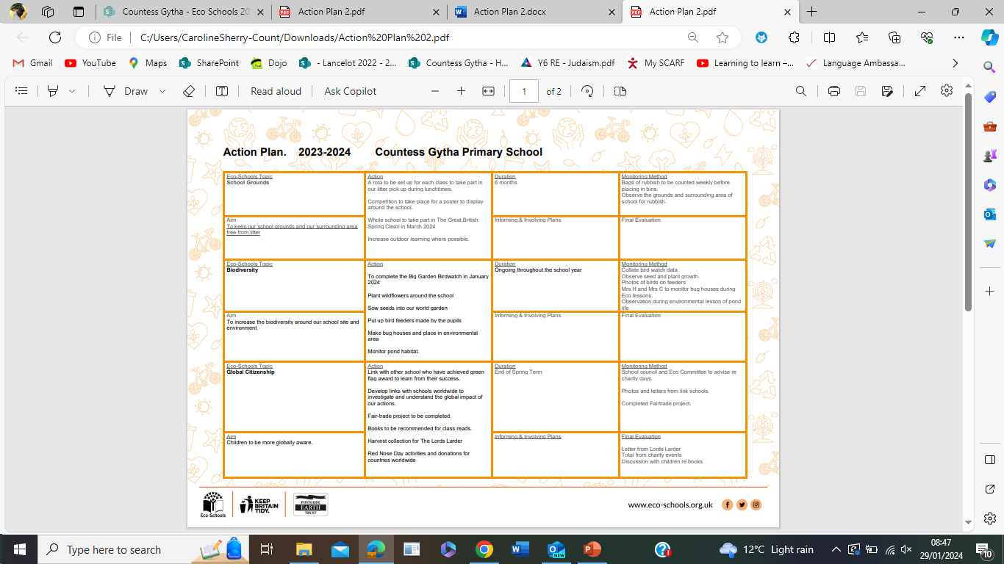

Slide 6
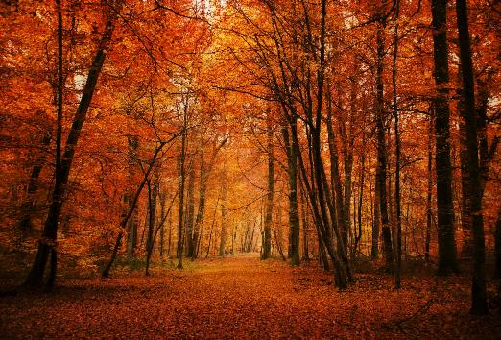
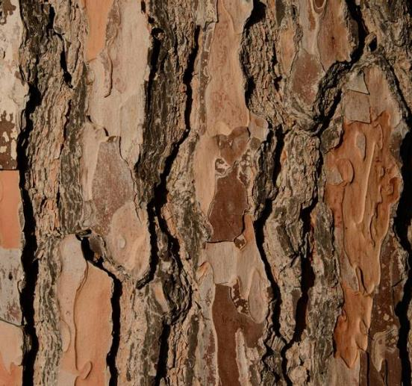
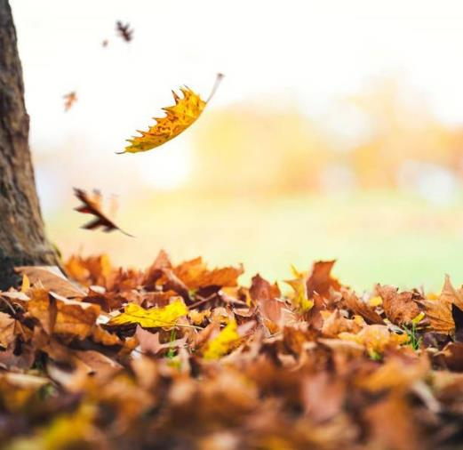

School Website
https://www.countessgythaprimary.co.uk/eco-schools/
. ​

Slide 7

SAFer Internet Week

