Slide 1
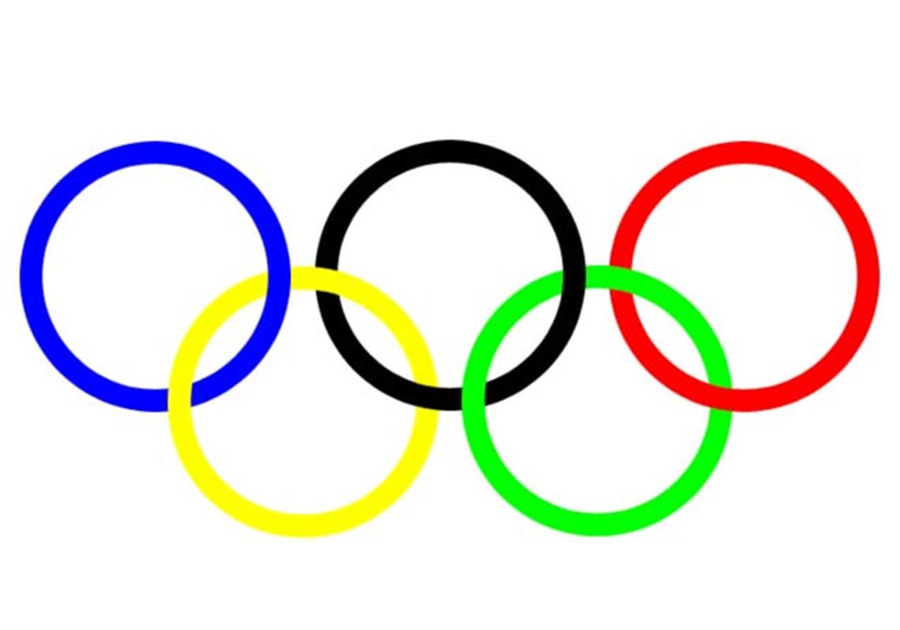
Olympic Mascots
It has been a tradition to have a mascot for each of the Olympic games.
Which mascots do you think were the wildest, craziest, weirdest and coolest?

Slide 2
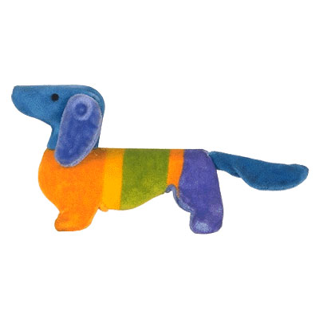
Waldi
The colourful dachshund was claimed to be the first official Olympic mascot at the 1972 Summer Games in Munich. Along with representing athletic qualities such as resistance, tenacity and agility, Waldi’s colours also symbolized the joy of the international event.

Slide 3
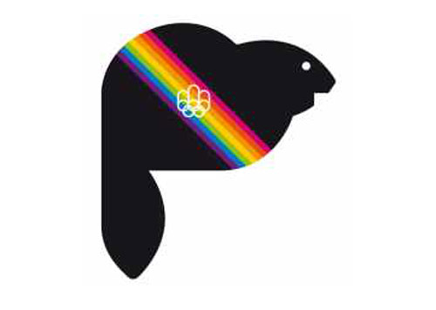
Amik the beaver was the mascot for Vancouver 1976. Amik meant beaver in a native Canadian language

Slide 4
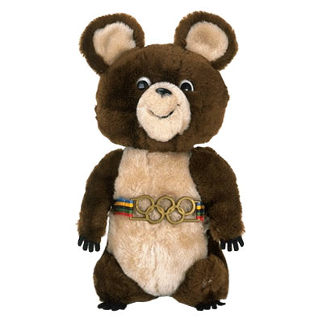
Misha - mascot of the 1980 Olympic games in Moscow.
Misha the bear cub proved to be very popular and lots of toys were designed around him. He became the first Olympics mascot to achieve commercial success in his own right.

Slide 5
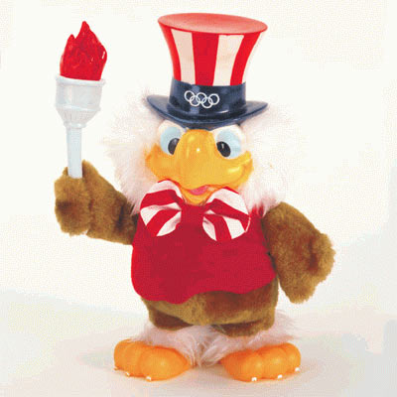
Sam
With the Summer Olympics being held in Los Angeles in 1984, Walt Disney decided to design a mascot. His creation was Sam, a cartoon eagle who’s not afraid of showing his true colours.

Slide 6
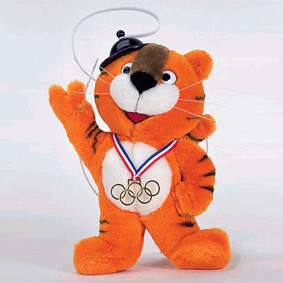
Hodori
This tiger was mascot for the 1988 Seoul Summer Olympics. Hodori was designed as good-natured tiger and portrayed the friendly and hospitable traditions of the Koreans.

Slide 7
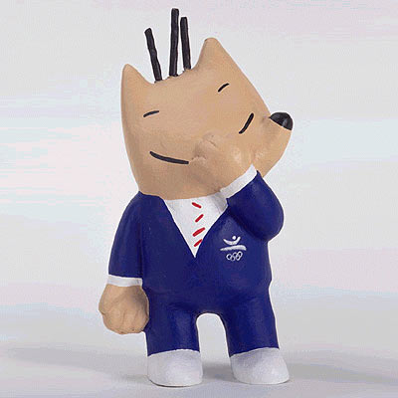
Cobi
It can be difficult to work out what exactly the 1992 Barcelona Summer Olympics mascot is. But the trick is to not look to hard because Cobi is simply a dog in a suit.

Slide 8
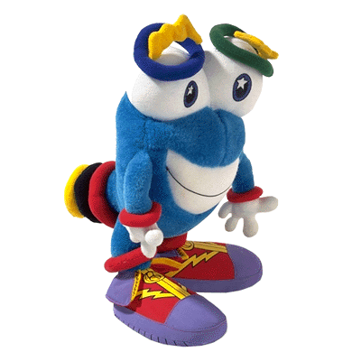
Izzy
This particular mascot was for the 1996 Atlanta Summer Olympics. Nobody knew what it was. That was the point; “Izzy” was an abstract fantasy figure derived from “What is it?”.

Slide 9
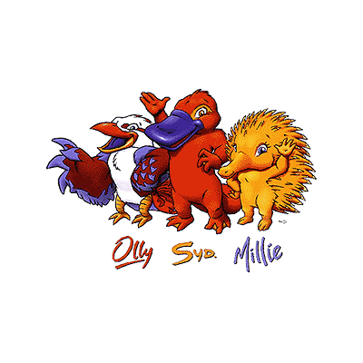
Ollie, Syd and Millie
This trio was perfect for the 2000 Sydney Summer Olympics. The kookaburra, platypus and echidna, all Australian animals, symbolized the event, the host city and the new millennium.

Slide 10
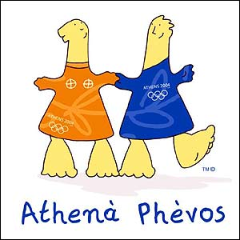
Athena and Phevos
Athens 2004 mascots were brother and sister and named after two Greek gods. Phevos, was the god of light and music, and Athena, goddess of wisdom and patron of the city of Athens
They are based on dolls 2000 years old found at archaeological sites in Greece.

Slide 11
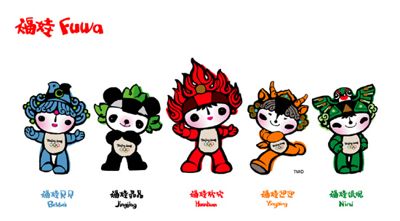
Fuwa - Like the Five Olympic Rings from which they drew their colour and inspiration, Fuwa served as the Official Mascots of Beijing 2008 Olympic Games, carrying a message of friendship and peace -- and good wishes from China -- to children all over the world.
Designed to express the playful qualities of five little children who form an circle of friends, Fuwa also show the natural characteristics of four of China's most popular animals -- the Fish, the Panda, the Tibetan Antelope, the Swallow -- and the Olympic Flame

Slide 12
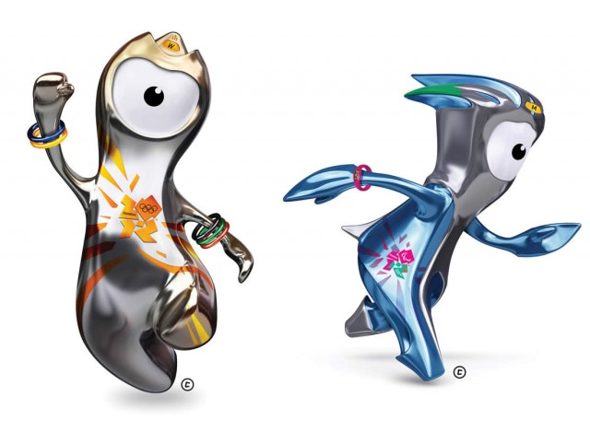
Wenlock and Mandeville were the mascots for the Olympic and Paralympic Games in London 2012. They were made with children in mind and will have their own animated series.
The characters are named after the village of Much Wenlock in Shropshire – which hosted a precursor to the modern Olympic Games in the 19th Century – and the birthplace of the Paralympic Games, Stoke Mandeville hospital in Buckinghamshire.

Slide 13
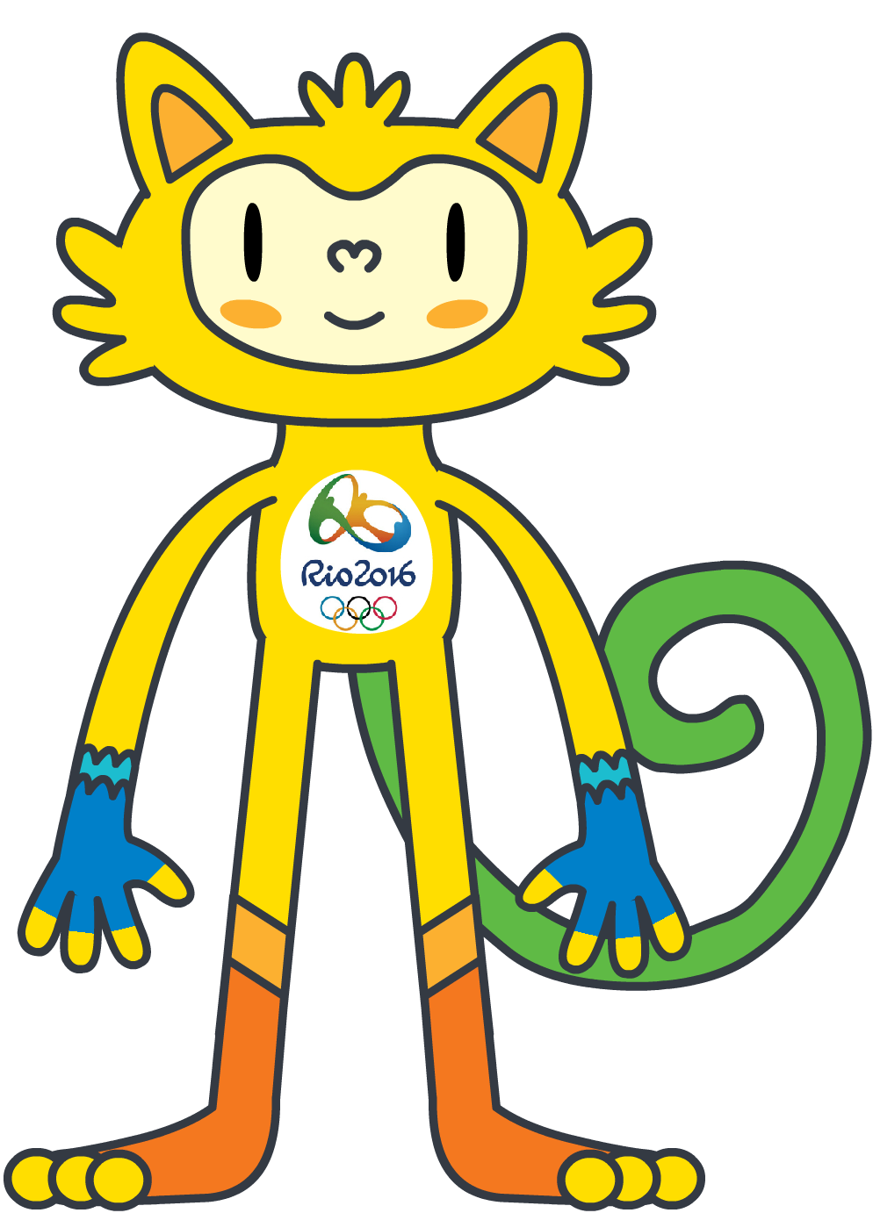
Named after one of Brazil’s most prominent 20th century cultural icons, Vinicius des Moraes, the mascot for the Olympic Games Rio 2016 constitutes a blend of animals native to Brazil, and symbolises the energy and joie de vivre exuded by the Brazilian people.
I’m Vinicius, the mascot for the Rio 2016 Olympic Games. I’m a mix of all of the different animals found in Brazil. Vinícius Rio 2016 - Vinícius Rio 2016

Slide 14
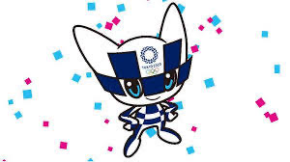
Miraitowa - Tokyo
The Olympic mascot is called Miraitowa, which is derived from the Japanese words “mirai” (future) and “towa” (eternity). This name was chosen to promote a future full of eternal hope in the hearts of people all over the world.
With its traditional and futurist style, the mascot embodies both the old and the new, echoing the concept of "innovation from harmony". Its forehead bears the emblem of the Tokyo 2020 Games, whose traditional chessboard motif is composed of indigo blue rectangles of three different sizes.

Slide 15
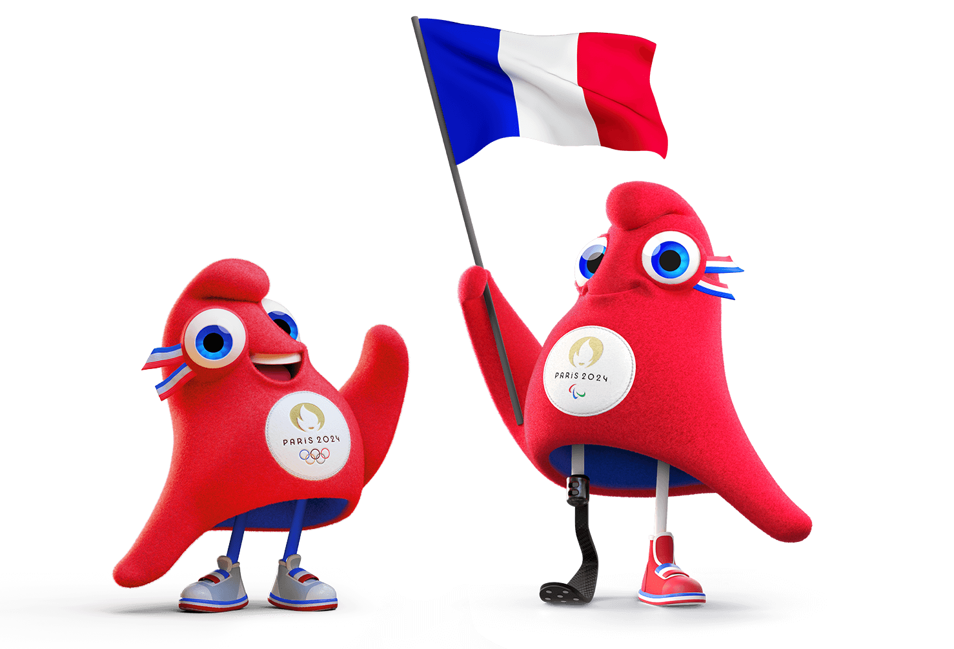
Paris 2024 presents the Phryges! These little Phrygian caps are the mascots for Paris 2024. The colourful red characters based on the famous Phrygian capis is a symbol of freedom. The Phrygians have stood shoulder to shoulder with the French people in all the key moments of History; they have been part of this and, today, they are convinced that sport can change everything! With the Phryges, let’s drive a revolution through Sport! The mascots want to play a role in the lives of French people and help bring more sport into our everyday life. And what could be better than little Phrygian caps to lead this revolution through Sport with Paris 2024?

